Slide 1
Joins and Indexes
Part I

Slide 2
Joins
Matching multiple columns from multiple tables
Based on a matching condition
Think: What do we want to know, from which column, of what table?
Build join query (or combine other operations) based on what you want to find out = “query”

Slide 3
Joins: Types and why we use them
Inner
Operation: exclusive, most common
Purpose: Include only matching rows from tables on both sides of join command.
Left / Right “outer”
Operation: inclusive matching
Purpose: Include all from inclusive side (left or right), and only the matching rows from other side.
Full
Includes ALL rows from both sides. (why bother? Just do a select *)
Because it is still a matching, not just a two column lists.
Cross
Operation: matches every record from one side to every record from the other side.
Purpose: Called a “Cartesian” join. Often to generate test data. Creates a result of all the permutations between the selected columns.
Self
Operation: For unary relations. Matches PK to Recursive FK in same table.
Purpose: We see this in manager/employee relations.
Inner
Left
Right

Slide 4
Why use joins?
Think about select of different columns from different tables:
SELECT employee.LastName, Department.DeptName
FROM Employee, Department
There is no matching, just two different unrelated lists of contents from selected columns.
Now add a matching condition:
Where employee.deptNo = department.DeptNo
Now sort it:
Order by deptName

Slide 5
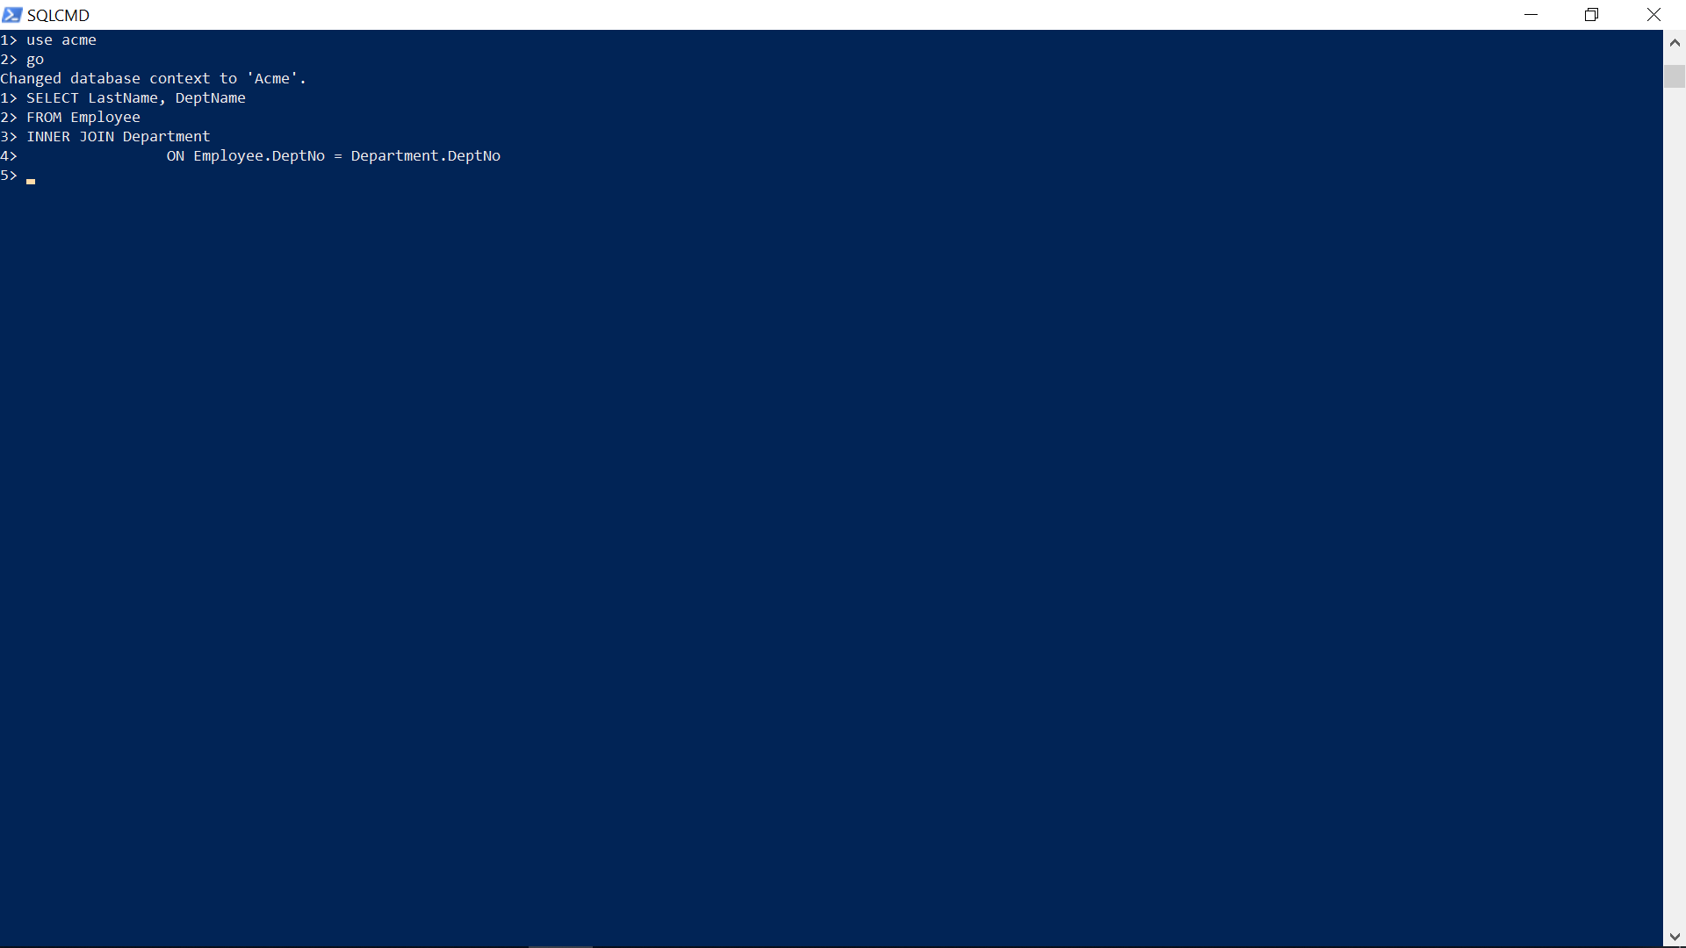
Same Select as a Join
SELECT LastName, DeptName
FROM Employee
JOIN Department
ON Employee.DeptNo = Department.DeptNo
Now add the same sorting operation:
Order by deptname

Slide 6
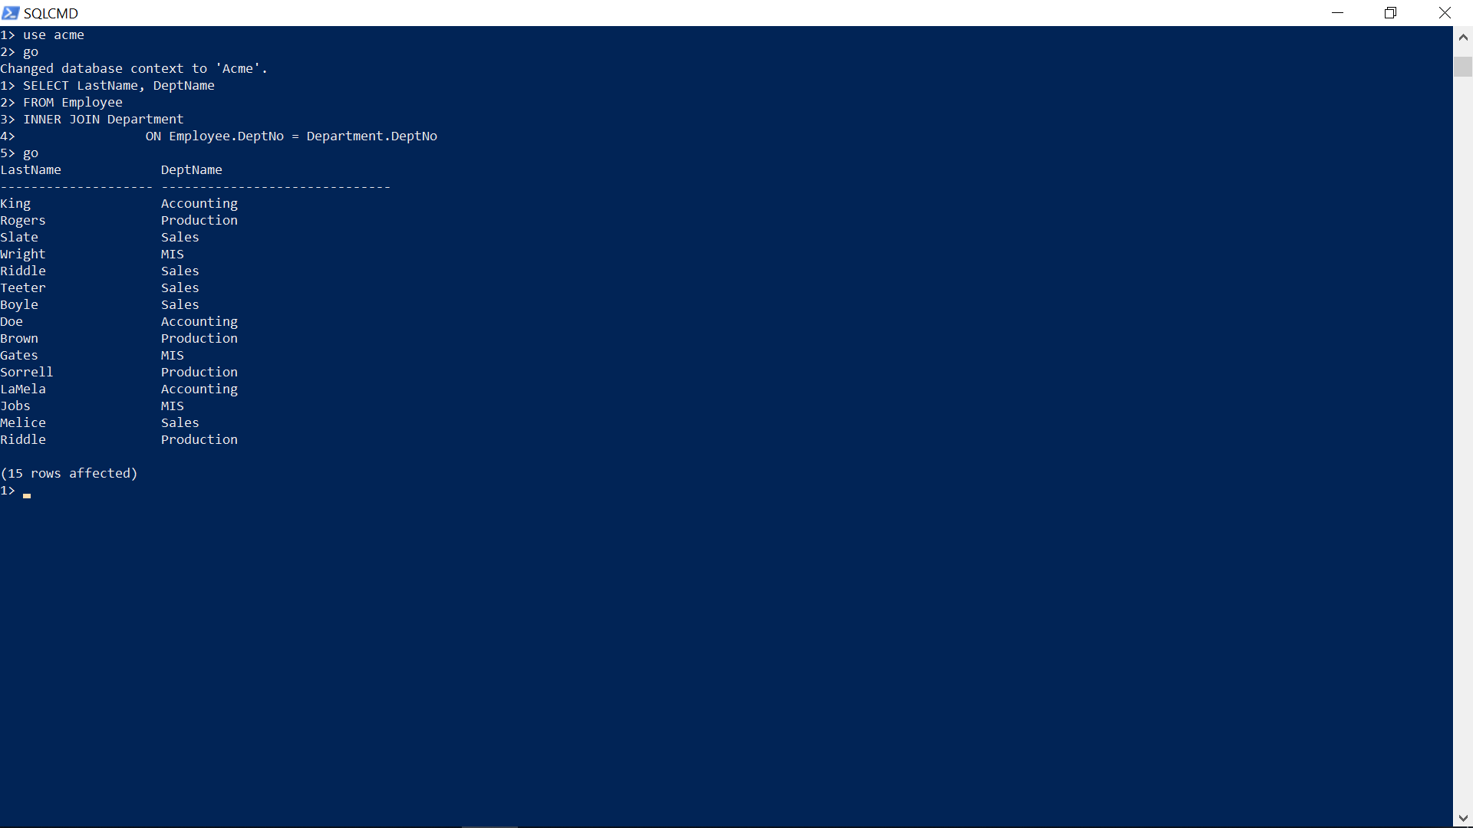
Notice how items in LastName and corresponding items in DeptName based on match between Employee DeptNo column with Department DeptNo column

Slide 7
Same Join with an Order by Sorting

Slide 8
So what is the lesson here?
Know there are Joins (inner, outer, full, cross)
Know there are many combinations of select operators and where conditions that can be used to answer questions we have = queries
Practice often.
The skill is about taking a question and converting it into a select or join query. Not the other way around.

Slide 9
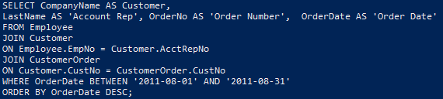
You can use combinations of tables, columns and conditions to answer questions about…
SELECT CompanyName AS Customer,
LastName AS 'Account Rep', OrderNo AS 'Order Number', OrderDate AS 'Order Date'
FROM Employee
JOIN Customer
ON Employee.EmpNo = Customer.AcctRepNo
JOIN CustomerOrder
ON Customer.CustNo = CustomerOrder.CustNo
#dialing in
WHERE OrderDate BETWEEN '2011-08-01' AND '2011-08-31'
ORDER BY OrderDate DESC;

Slide 10
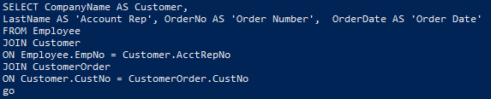
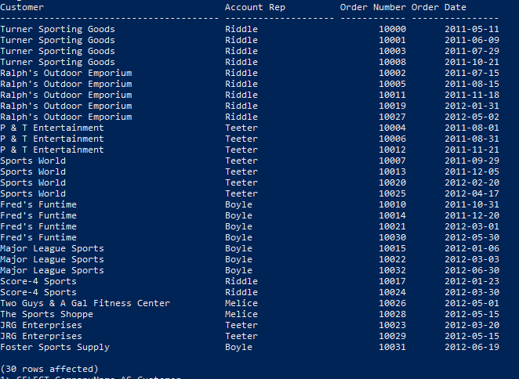

Slide 11
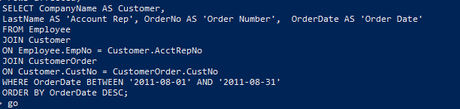
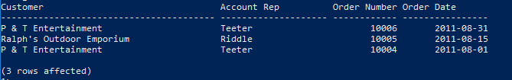

Slide 12
Complex Join Example
SELECT CustomerOrder.OrderNo AS 'ORDER NO',
OrderDate AS DATE,
SUM(Quantity * ActualPrice) AS 'ORDER TOTAL'
FROM CustomerOrder
JOIN OrderLine
ON CustomerOrder.OrderNo = OrderLine.OrderNo
WHERE OrderDate BETWEEN '2011-01-01' AND '2011-12-31'
GROUP BY CustomerOrder.OrderNo, OrderDate
ORDER BY SUM(Quantity * ActualPrice) DESC;

Slide 13
Outer Join Syntax
SELECT
FROM
LEFT JOIN
ON
WHERE Date BETWEEN
GROUP BY
ORDER BY SUM(_____)DESC;
SELECT
FROM
RIGHT JOIN
ON
WHERE Date BETWEEN
GROUP BY
ORDER BY SUM(_____) DESC;

Slide 14
Compare:
SELECT OrderDate, CompanyName
FROM CustomerOrder
Left JOIN Customer
ON CustomerOrder.CustNo = Customer.CustNo
order by orderdate
SELECT OrderDate, CompanyName
FROM CustomerOrder
Right JOIN Customer
ON CustomerOrder.CustNo = Customer.CustNo
order by orderdate

Slide 15
Cross Join Syntax
Select Table.column, Table.column
From table one
Cross Join table two

Slide 16
Union, Union All
Append two Selects
I don’t have any good examples.
Just know this operator exists.

Slide 17
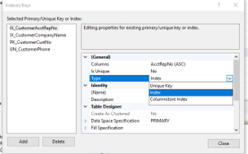
Indexes: Why use them? - It makes scanning tables faster
Index (implies non-unique)
Column Store Index ( data warehousing)
Unique (enforces non-repeating rows in that column)
Clustered (maps entire table at leaf of the B-tree)
Non Clustered (is a pointed at the leaf of the B-tree)

Slide 18
Indexes: Rules to Know
Can’t modify (alter is deceiving)
Must drop and start over
So get it right the first time
If not first column in your select than it is ignored!
B-tree, leaf and node
Read/write trade-off (OLTP/OLAP)

Slide 19
Clustered Key
PK defaults Clustered unless keyword NOTCLUSTERED
Only one per table so choose wisely!
Clustered Key
Full table physically stored (Only one per table), leaf is the actual data.
Takes up more space
Good for range based selects (Group by, Order by, Min/Max, Count, Between)
Higher page density (less pages to read)
Bad for inserts (writes)
Non-clustered key
Leaf is a pointer to the data
Good for OLTP (lower page density, lots of writes)

Slide 20
Create/Drop Index Command
Create Index IX_TablenameColumnName
On Tablename (column)
Drop Index IX_TablenameColumnName
On Tablename
CREATE INDEX IX_CustomerOrderOrderDate
ON CustomerOrder (OrderDate)
drop Index IX_CustomerOrderOrderDate
On CustomerOrder

